Slide 1
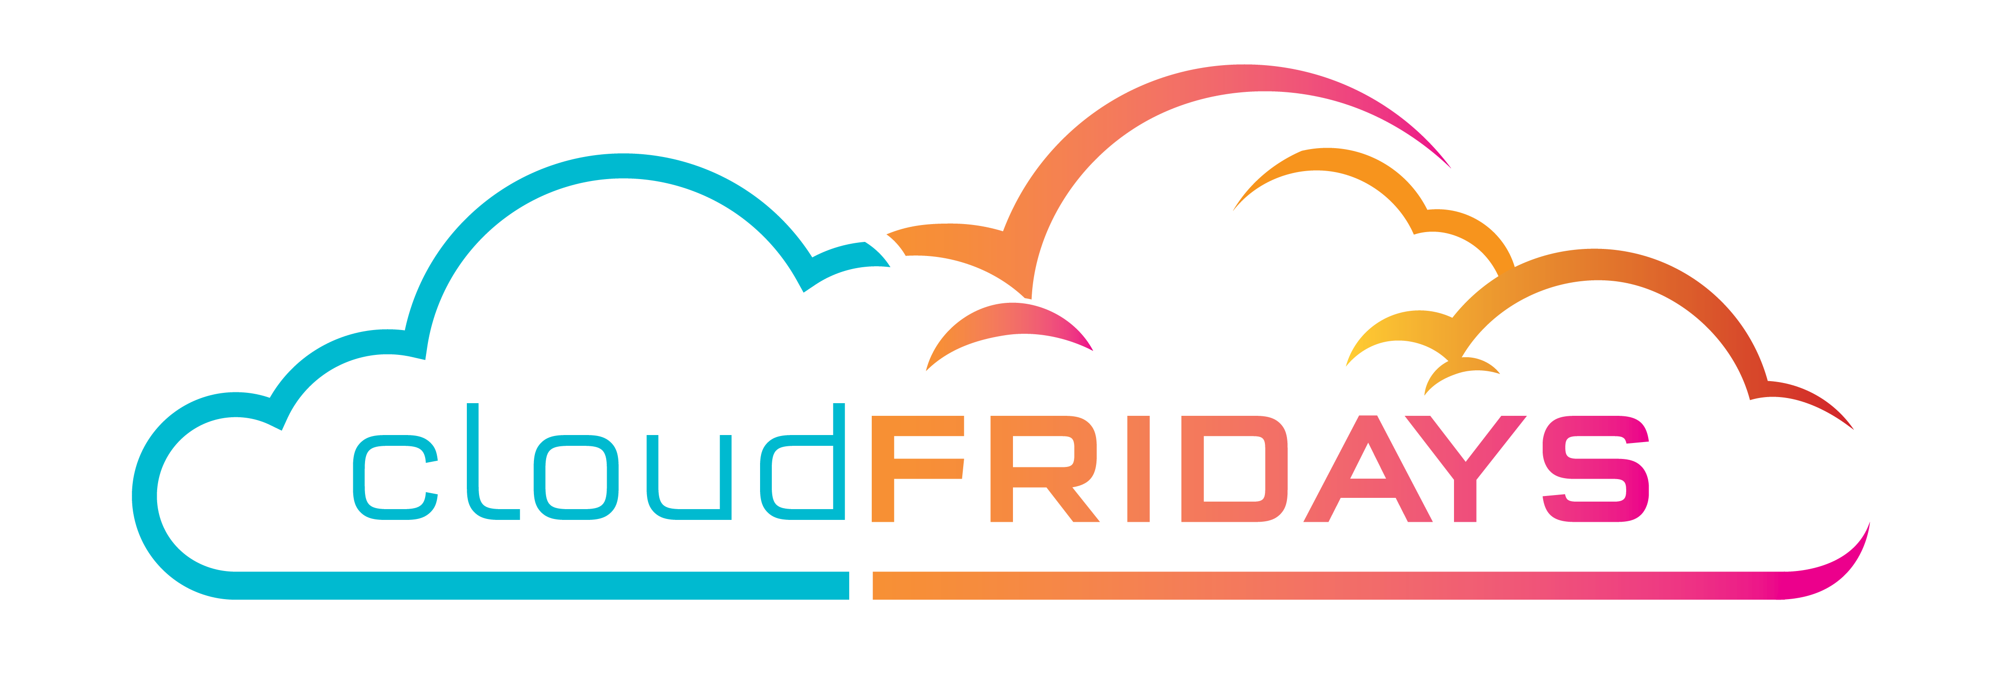

Azure Cost Management
Matthew Levy

Slide 2


Happy “Cupcake” Day

Slide 3
Cloud math is the kind of math that school warned you about:
Mary bought:
2Kg of flour R27.00
500g of butter R75.00
2Kg of sugar R29.00
1 dozen eggs R62.70
2 vanilla pods R110.00
She made:
1 dozen cupcakes
1 small round cake
1 large round cake
2 medium square cakes

Slide 4
Calculate the cost of one cupcake

Slide 5

Usage meters
When you provision an Azure resource, Azure creates one or more meter instances for that resource. The meters track the resources' usage, and generate a usage record that is used to calculate your bill.

Slide 6
Factors affecting costs
Resource type
Units and Rate depend on Resource Type
Services
First-party rates vs third-party rates
Location
Popularity, demand, and local infrastructure costs
Billing Zones
Geographical grouping

Slide 7

Zones
Zone | Areas
Zone 1 | United States, US Government, Europe, Canada, UK, France, Switzerland
Zone 2 | East Asia, Southeast Asia, Japan, Australia, India, Korea
Zone 3 | Brazil, South Africa, UAE
DE Zone 1 | Germany
Not to be confused with Availability Zones

Slide 8
“How much will the Cloud cost?”

Slide 9
It depends.

Slide 10
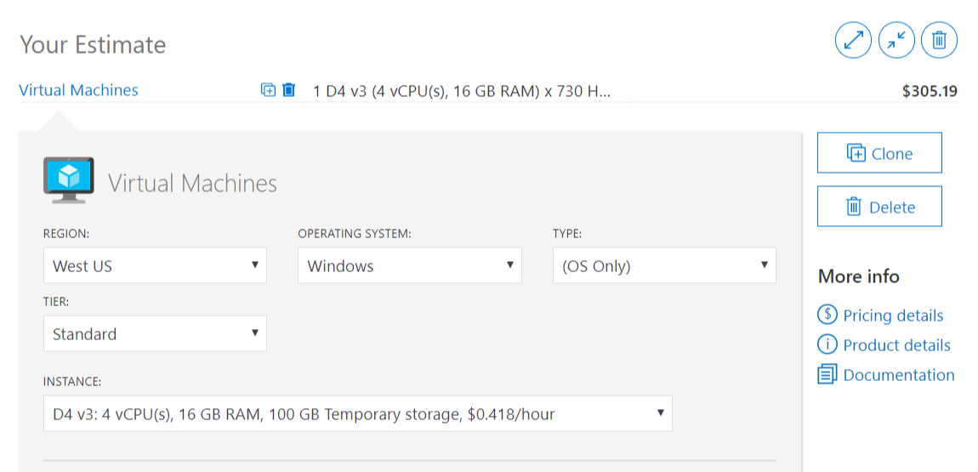
Azure Pricing Calculator (DEMO)

Slide 11
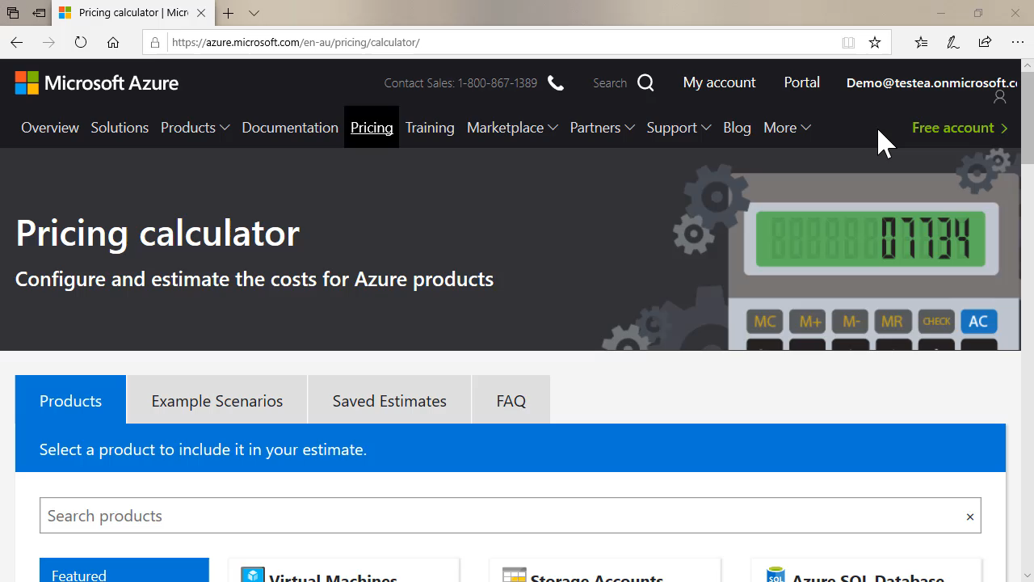
Total Cost of Ownership Calculator
azure.microsoft.com/pricing/tco/calculator/

Slide 12
Who is responsible for Cloud Cost?
CFO
CIO
CTO
I.T. Manager
I.T. Operations
Developers

Slide 13
Capital Expenditure (CapEx)
Financial considerations
Operational Expenditure (OpEx)
Asset appears on Balance Sheet
Increases business value
Reduces taxes via depreciation
Cost appears on Profit & Loss Statement
Directly reduces net profit
Reduces income subject to tax

Slide 14
“Will the Cloud be cheaper?”

Slide 15
Tailwind Traders wants to migrate 3 physical Windows Server 2008 R2 servers to the Cloud. Will this be cheaper than operating them on-premises over the next 2 years?

Slide 16
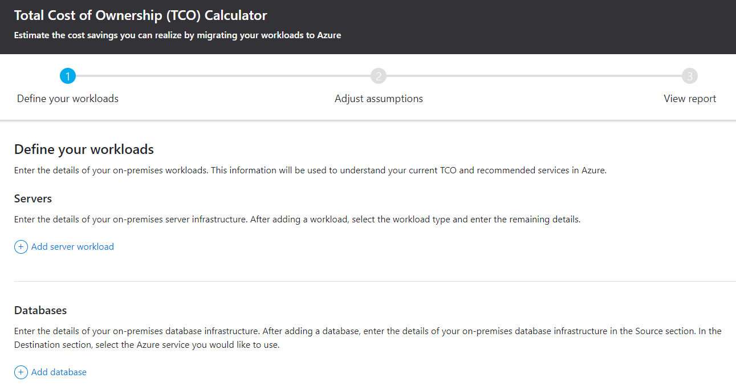
Azure Total Cost of Ownership Calculator (DEMO)

Slide 17
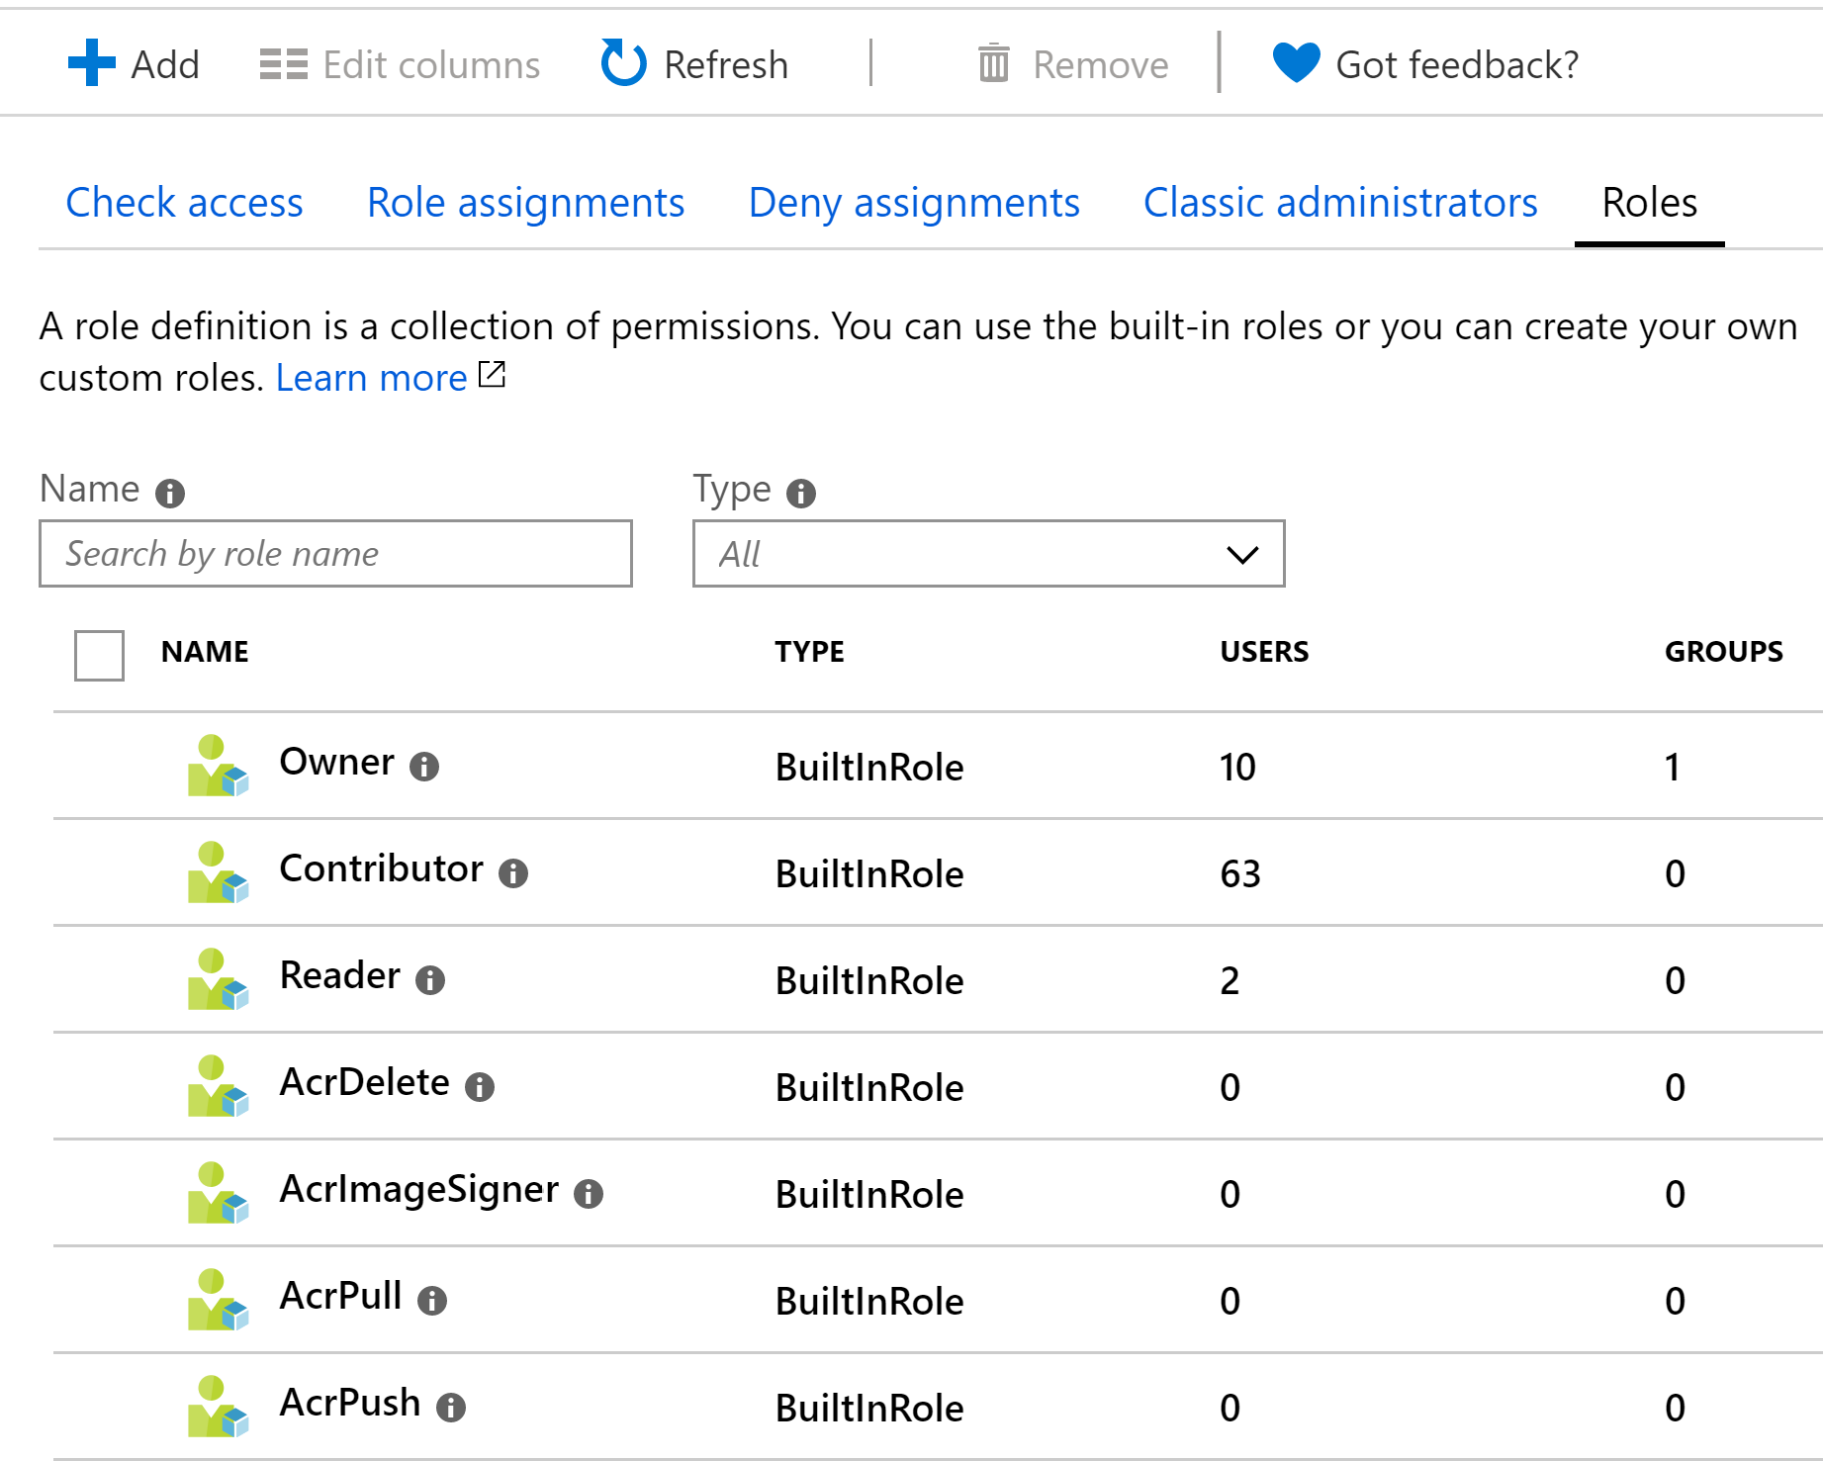
Role Based Access Control
Categorize resources across different resource groups and subscriptions
for billing, management, and operational purposes.
Identify common tags (such as CostCenter, ApplicationOwner)
Apply them consistently using automation & Azure Policy.
Restrict who has access to create resources
Define who has access to cost data

Slide 18
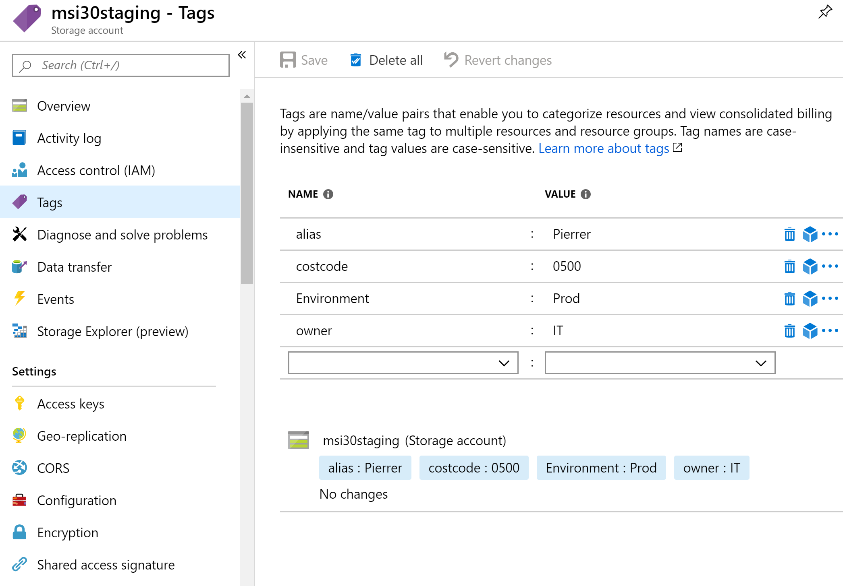
Resource tags
Categorize across different resource groups and subscriptions
Identify common tags (such as CostCenter, Environment)
Portal, Templates, PowerShell, Azure CLI, REST API
Enforce usage with Azure Policy
Categorize resources across different resource groups and subscriptions
for billing, management, and operational purposes.
Identify common tags (such as CostCenter, ApplicationOwner)
Apply them consistently using automation & Azure Policy.

Slide 19
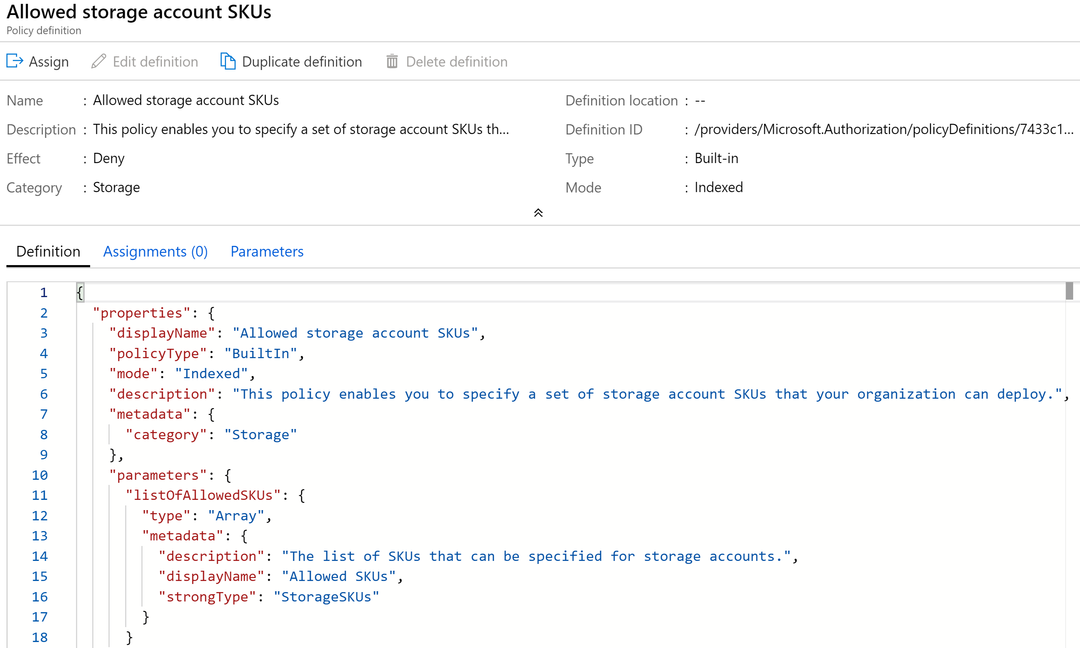
Azure Policy
Categorize resources across different resource groups and subscriptions
for billing, management, and operational purposes.
Identify common tags (such as CostCenter, ApplicationOwner)
Apply them consistently using automation & Azure Policy.
Restrict expensive SKUs
Apply Tags

Slide 20
“How will we know if we’re spending too much, BEFORE we get the invoice?”

Slide 21
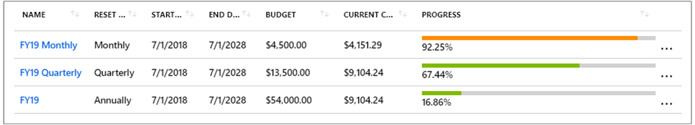
Azure Budgets (DEMO)
https://msit.microsoftstream.com/video/39f5193c-4396-4332-abc3-c492e3a4f5c3?channelId=b9f7d4d3-e1c8-4804-b914-1b4098ac5997
https://msit.microsoftstream.com/video/39f5193c-4396-4332-abc3-c492e3a4f5c3?channelId=b9f7d4d3-e1c8-4804-b914-1b4098ac5997

Slide 22
“Where are all of our costs coming from?”

Slide 23

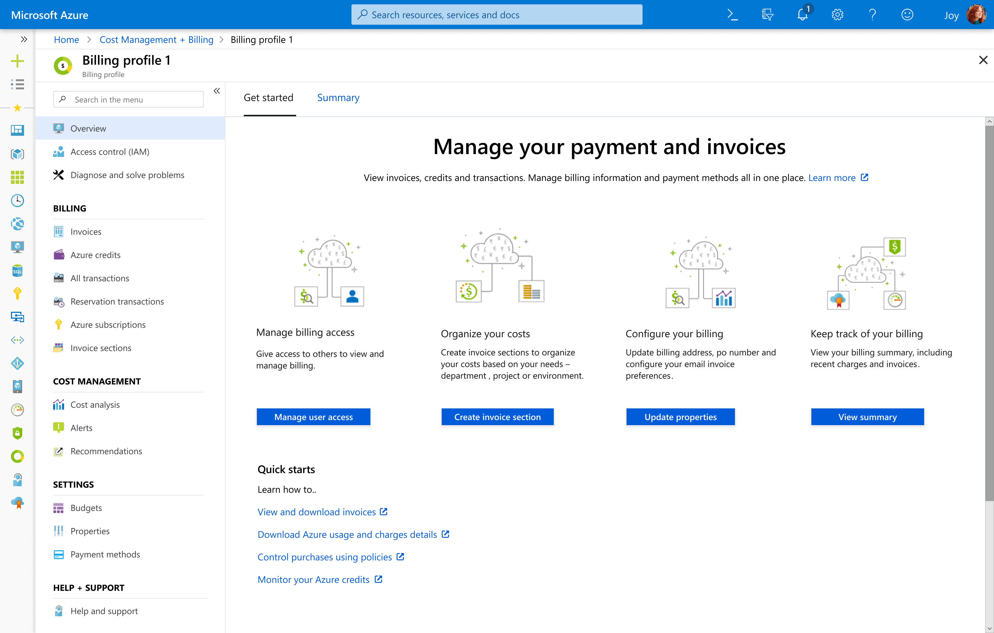
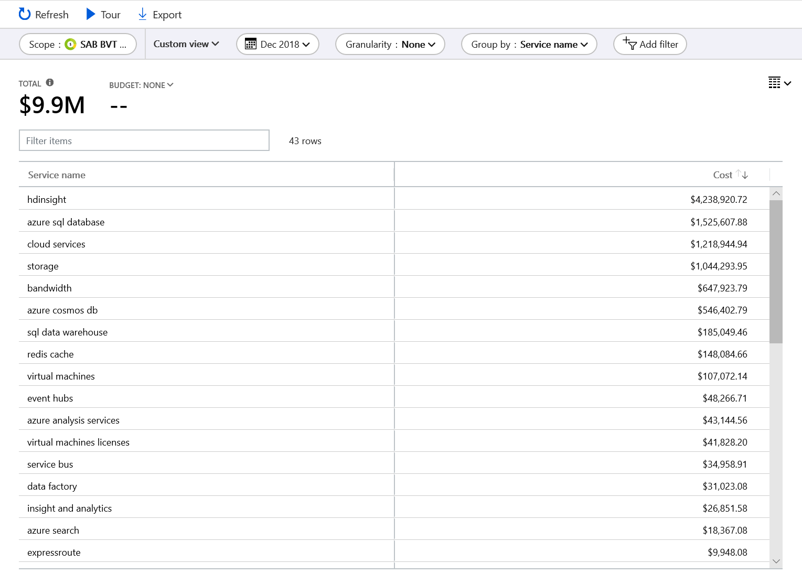
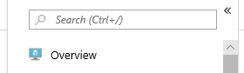
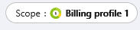
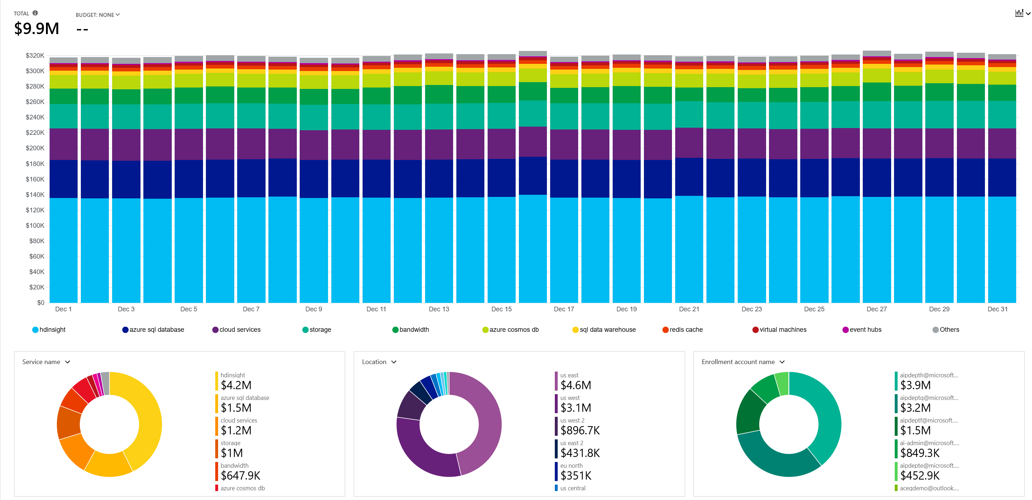
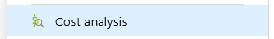
Azure Cost Analysis (DEMO)

Slide 24
“Can we save any money?”

Slide 25
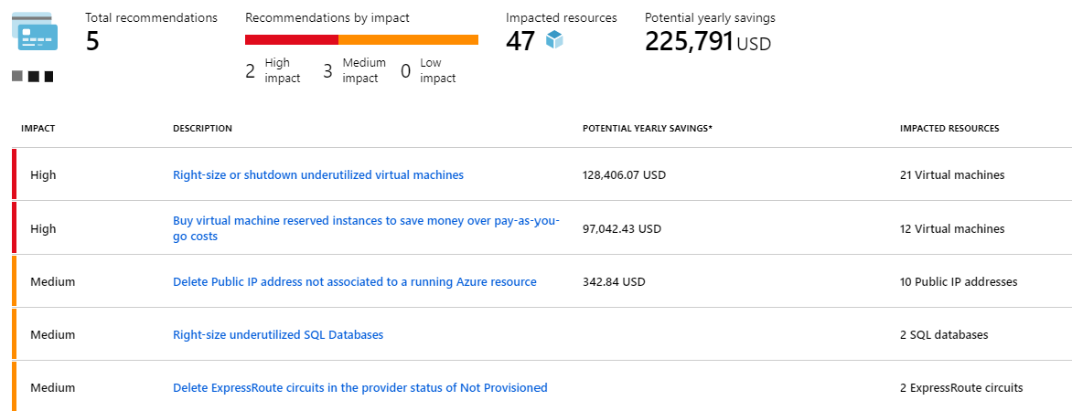
Azure Advisor

Slide 26
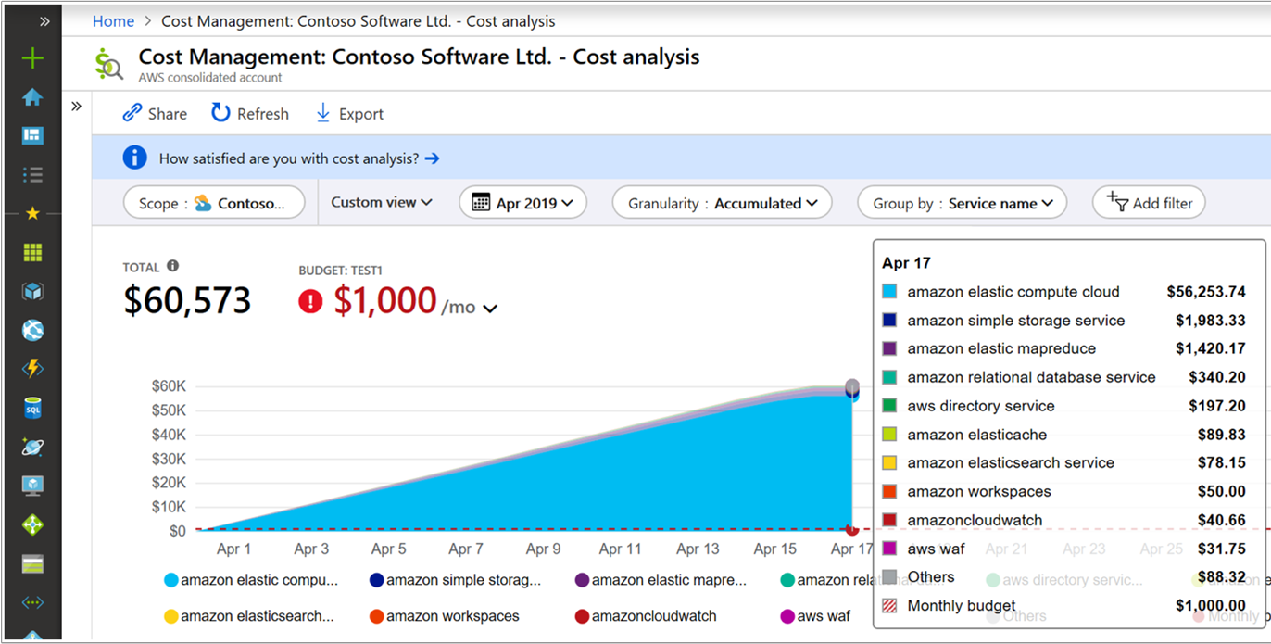
AWS Cost Data via Azure Cost Management
https://docs.microsoft.com/azure/cost-management/aws-integration-set-up-configure?WT.mc_id=twitter-social-socuff
https://docs.microsoft.com/azure/cost-management/aws-integration-manage?WT.mc_id=twitter-social-socuff

Slide 27
The key takeaway is that resources are always charged based on usage. For example, if you de-allocate a VM then you will not be billed for compute hours, I/O reads or writes or the private IP address since the VM is not running and has no allocated compute resources. However you will incur storage costs for the disks.
Note
De-allocating a VM is not the same as deleting a VM. De-allocation means the VM is not assigned to a CPU or network in a datacenter. However, your persistent disks remain, and the resource is present in your subscription. It's similar to turning off your physical computer.

Slide 28
Cost Management tools in Azure
Tool | Azure portal | Azure Cost Management | Azure EA Content Pack | Azure Policy
Enterprise Agreement required? | No | No | Yes | No
Budget control | No | Yes | No | Yes
Monitor spending on single resource | Yes | Yes | Yes | No
Monitor spending across multiple resources | No | Yes | Yes | No
Control spending on single resource | Yes - manual sizing | Yes | No | Yes
Enforce spending across multiple resources | No | Yes | No | Yes
Enforce accounting metadata on resources | No | No | No | Yes
Monitor and detect trends | Yes | Yes | Yes | No
Detect spending anomalies | No | Yes | Yes | No
Socialize deviations | No | Yes | Yes | No

Slide 29
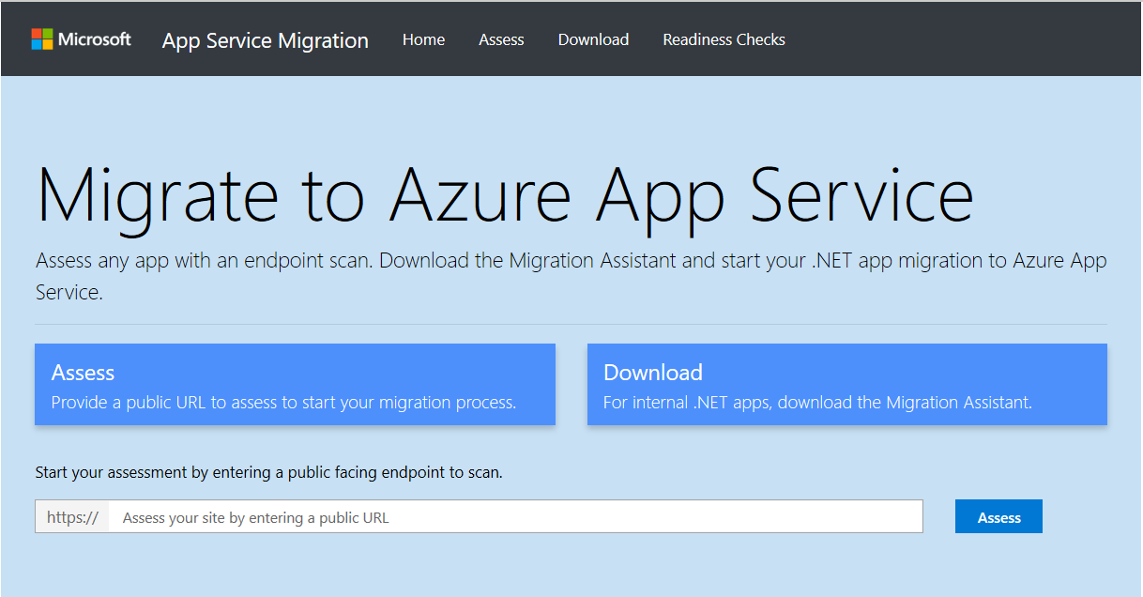
Appmigration.microsoft.com

Slide 30
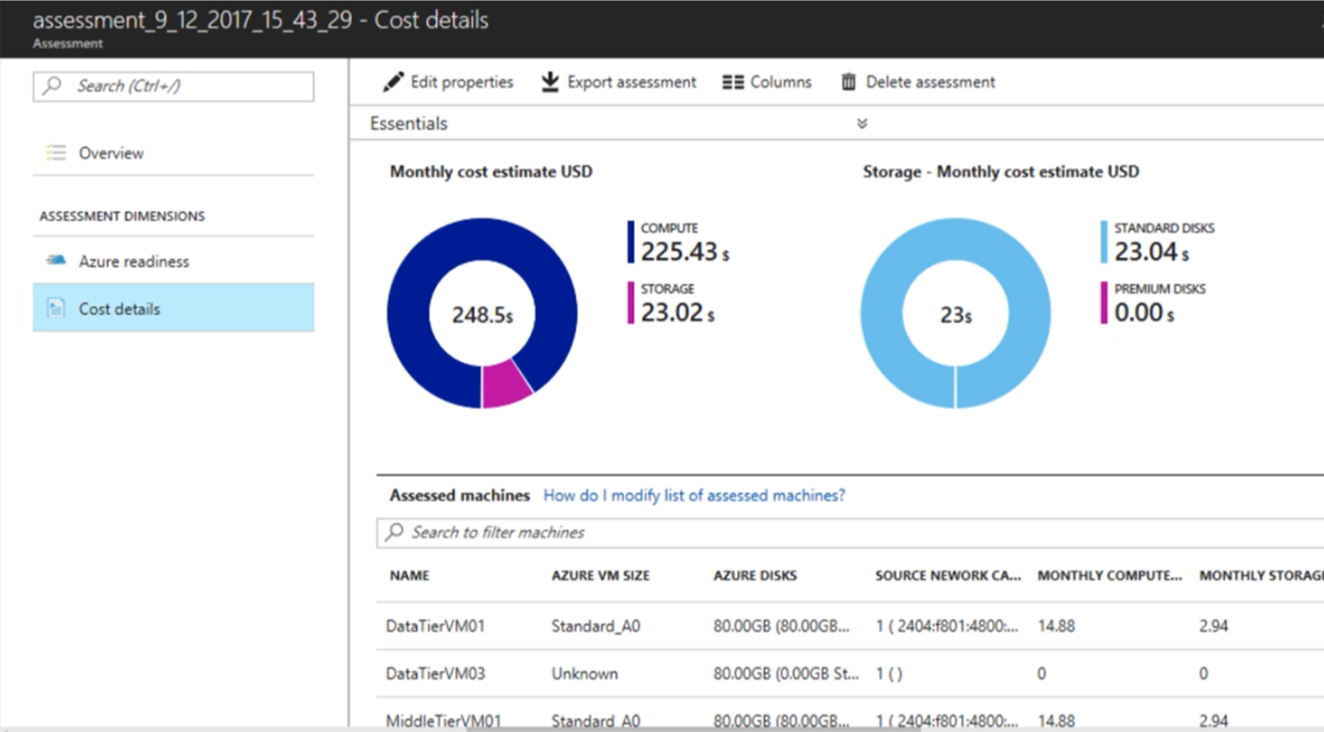
Azure Migrate
On-prem VMware VMs
Hyper-V VMs

